Slide 1
Avatar Architecture
ML2700, Back-end

Slide 2
Homework
Create an API for receive request and response data through:
PostMan <-> API
Controller <-> Function <-> DAO <-> ES

Slide 3








Avatar Architecture - Abstraction
Front-End
Message Queue
Data Storage
Angular
HTML5
CSS3
Oracle
REST
Back-End
Tomcat
SAP
SFCS
Consumer
Others

Slide 4



Avatar Architecture - HW
NginX 1
NginX 2
NginX 3
Tomcat 1
Tomcat 2
Tomcat 3
Active
Active
Active
Active
Active
Active
Kafka 1
Consumer
Kafka 2
Consumer
Kafka 3
Consumer
Kafka
Broker 1
Kafka
Broker 2
Kafka
Broker 3
Active
Active
Active
Active
Active
Active

Slide 5


Avatar Architecture - HW
ElasticSearch 1
ElasticSearch 2
ElasticSearch 3
Oracle
Oracle
Oracle
Oracle
Active
Active
Active
Active
StandBy
Redis 1
Redis 2
Redis 3
Redis Single
Active
Active
Active
Active

Slide 6

Basic Back-End Flow
Back-End
Data Storage
Angular
Oracle
Controller
VO
Function
VO
Message Queue
DAO

Slide 7
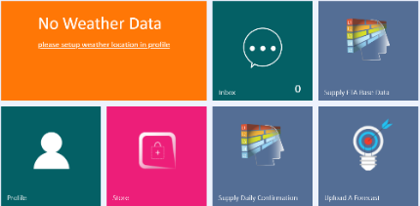


Avatar Web Service
Front-End
Back-End
Data Storage
Json
Rest API
(Controller)
Oracle
Java Object
Service
(Function)
Java Object
DAO

Slide 8
Avatar Consumer
Message-Bus
Back-End
Data Storage
XML,
Json
Kafka Consumer
(Controller)
Oracle
SAP
Java Object
Service
(Function)
SFCS
Others
Java Object
DAO
Notes:
萃取（extract）、轉置（transform）、載入（load）

Slide 9
Avatar Batch Jobs
Quartz Scheduler
Back-End
Data Storage
Json
Job API
(Controller)
Oracle
Java Object
Service
(Function)
Java Object
DAO

Slide 10
ElasticSearch, Kafka, Redis, MQTT
ML2700, Back-end

Slide 11
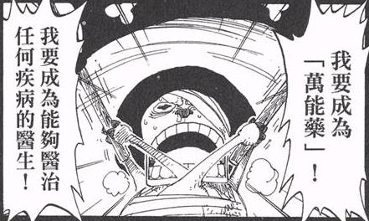
About Open Source…
世上沒有萬靈丹….
知其然, 知其所以然

Slide 13
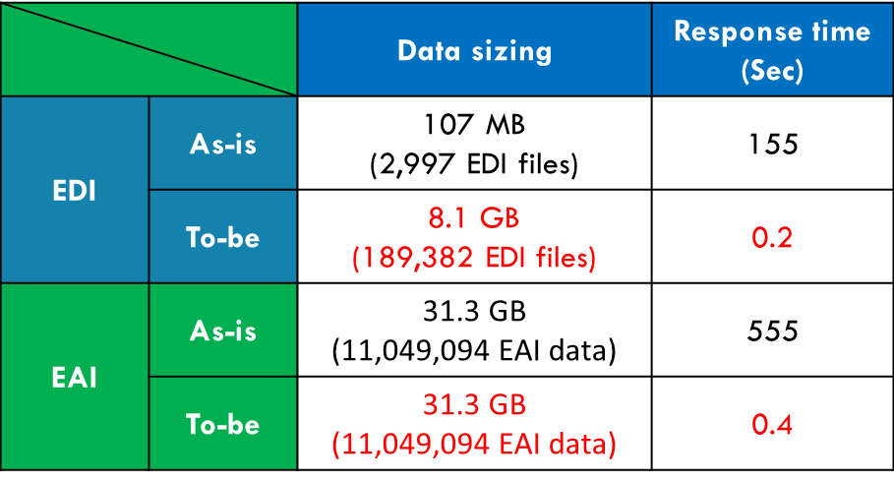
What is ElasticSearch (ES)?
Highly scalable open-source full-text search and analytics engine that is accessible through a RESTful interface
Store, search, and analyze big volumes of data quickly and in near real time
Cloud architecture: a collection of one or more nodes (servers) that together holds your entire data
http://ebiz-eda.wistron.com
Notes:
Definition of Cloud Computing (NIST, 2009)
- On-demand self-service
- Broad network access
- Resource pooling
- Rapid elasticity
Measured service
隨選所需自助服務：用戶可以自行配置運算能力，像是伺服器運作時間與網路儲存空間，而且是在不需要服務供應商人工介入的情況下自動運作。
● 網路存取方式多樣化：雲端運算要能透過網路取得，並且能以標準的連線機制促成各式異質的終端平臺存取。（例如手機、筆記型電腦、掌上型電腦）
● 共用資源池：服務供應商的運算資源必須整合為一個共用資源池，依照用戶的需求，動態配置或取消實體與虛擬化的運算資源，達到多位用戶共同使用的多租戶型式。在某種程度上，運算資源所在位置有一定隔離，用戶無從得知運算資源真正所在位置，亦無法對其控制，但用戶能夠從更抽象的層次了解運算資源所在地（例如國家、洲或資料中心）。而這些運算資源包括了儲存空間、處理器、記憶體、網路頻寬與虛擬伺服器。
● 迅速伸縮自如：雲端運算在配置運算資源時，可迅速伸縮自如，既可快速擴增架構，亦可快速縮小架構，在一些情況下甚至能夠自動化運作。對用戶而言，像是有毫無限制的運算資源可供配置，而且可以隨時隨意購買。
● 服務可量測：雲端運算系統擁有服務量測能力（例如儲存空間、處理器、頻寬與使用人數），並能自動控制運算資源的使用與最佳化。資源的使用情況可以被監控、控制、匯報，對供應商與用戶而言，都如同使用水電服務一樣地透明化。

Slide 14
Basic Concepts for ES
Cluster
A collection of one or more nodes (servers) that together holds your entire data and provides federated indexing and search capabilities across all nodes
Node
A single server that is part of your cluster, stores your data, and participates in the cluster’s indexing and search capabilities
http://10.37.36.2:9200/_plugin/kopf/#!/cluster

Slide 15

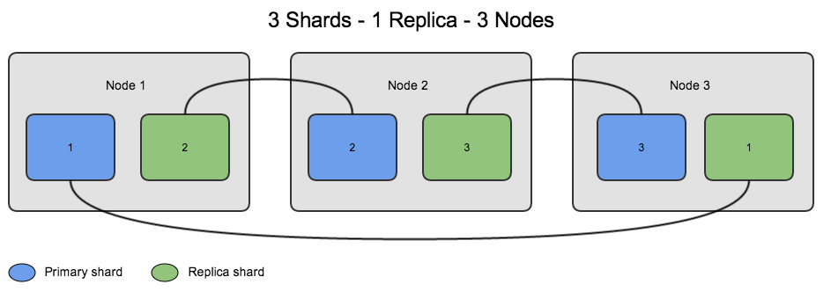
Basic Concepts for ES
Shard
Provides the ability to subdivide index into multiple pieces called shards
Distribute and parallelize operations across shards thus increasing performance / throughput
Replica
Provides high availability in case a shard/node fails

Slide 16
Basic Concepts for ES
Document
a basic unit of information that can be indexed
Fields
used to control how the document metadata is indexed.
Type
a logical category/partition of all documents in the specific index
Index
a collection of documents that have somewhat similar characteristics

Slide 17
Basic Concepts for ES
http://10.37.36.2:9200/_plugin/head/
ElasticSearch | RDB
Index | DB
Type | Table
Fields | Column
Document | Raw Data

Slide 18
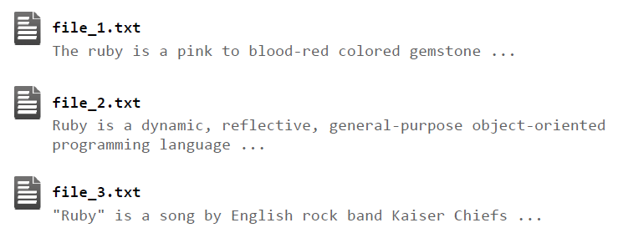
How ElasticSearch works
When we have many documents

Slide 19
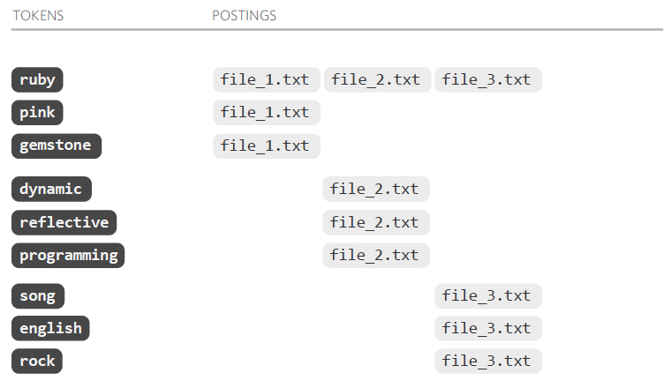
How ElasticSearch works
The inverted index

Slide 20
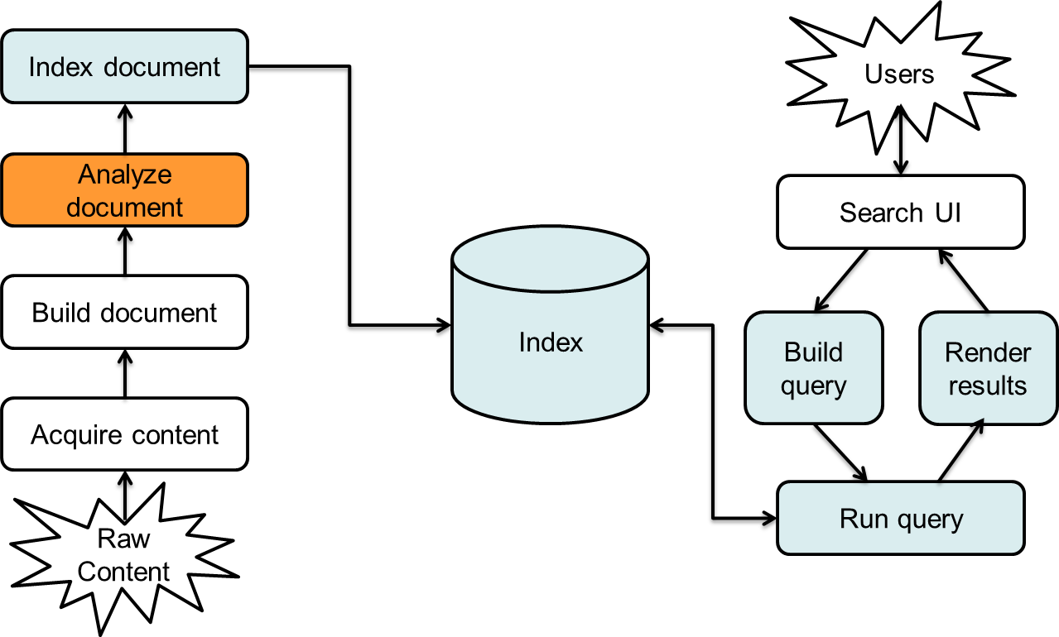
How ElasticSearch works

Slide 21

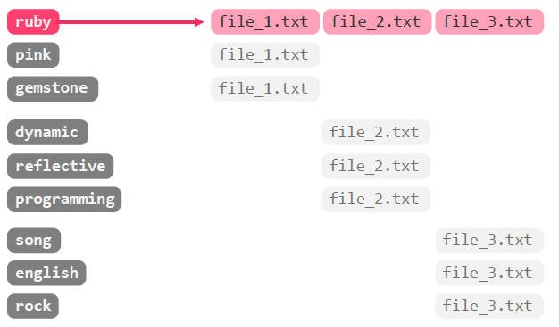
How ElasticSearch works
ruby

Slide 22
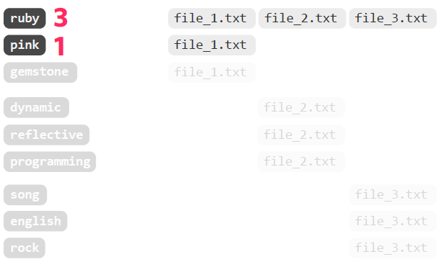
How ElasticSearch works
ruby OR pink

Slide 23


Slide 24
What is Redis?
Redis is an open source, in-memory data structure store (using the disk only for persistence), used as a database (lightweight), cache and message broker
It supports data structures such as strings, hashes, lists, sets
Redis is written in ANSI C and works in most POSIX systems like Linux and OS X
REDIS can replicate data to any number of slaves.
Notes:
可移植作業系統埠（英語：Portable Operating System Interface，縮寫為POSIX）是IEEE為要在各種UNIX作業系統上執行軟體，而定義API的一系列互相關聯的標準的總稱，其正式稱呼為IEEE Std 1003，而國際標準名稱為ISO/IEC 9945。此標準源於一個大約開始於1985年的專案。POSIX這個名稱是由理察·斯托曼（RMS）應IEEE的要求而提議的一個易於記憶的名稱。它基本上是Portable Operating System Interface（可移植作業系統埠）的縮寫，而X則表明其對Unix API的傳承。

Slide 25
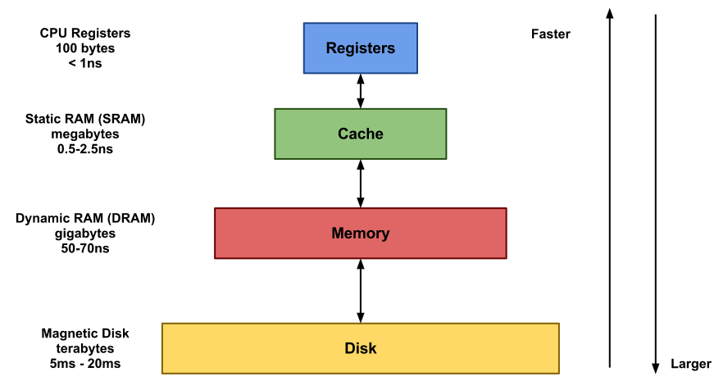
What is Redis?
In-memory

Slide 26
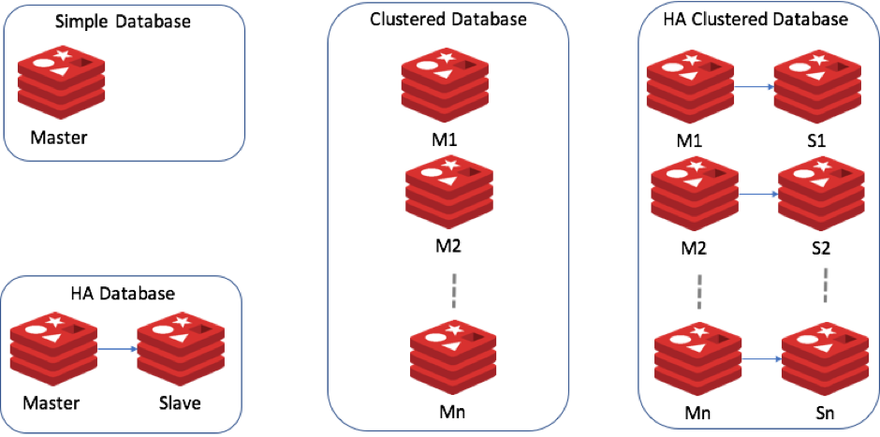
Redis Cluster
Cluster and Master/Slave
Note that the minimal cluster that works as expected requires to contain at least three master nodes (https://redis.io/commands/cluster-slots)
HA: highly available

Slide 27
Redis Cluster
Better way to implement Redis cluster
Server 1
Server 2
Server 3
M1
M2
M3
S3
S1
S2
S2
S3
S1

Slide 28
Redis Data Type - String
The simplest type of value you can associate with a Redis key
Using the SET and the GET commands are the way we set and retrieve a string value
Values can be strings (including binary data) of every kind, for instance you can store a jpeg image inside a value. A value can't be bigger than 512 MB
> set mykey somevalue
OK
> get mykey
"somevalue"

Slide 29
Redis Data Type - String
The ability to set or retrieve the value of multiple keys in a single command is also useful for reduced latency. For this reason there are the MSET and MGET commands
> mset a 10 b 20 c 30
OK
> mget a b c
1) "10"
2) "20"
3) "30"

Slide 30
Redis Data Type - String
For example the EXISTS command returns 1 or 0 to signal if a given key exists or not in the database, while the DEL command deletes a key and associated value, whatever the value is.
> set mykey hello
OK
> exists mykey
(integer) 1
> del mykey
(integer) 1
> exists mykey
(integer) 0

Slide 31
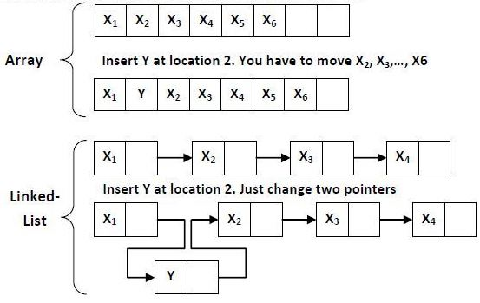
Redis Data Type - List
Redis list are implemented via Linked Lists
This means that even if you have millions of elements inside a list, the operation of adding a new element in the head or in the tail of the list is performed in constant time (O(1))

Slide 32
Redis Data Type - List
The LPUSH command adds a new element into a list, on the left (at the head), while the RPUSH command adds a new element into a list ,on the right (at the tail)
The LRANGE command extracts ranges of elements from lists
> rpush mylist A
(integer) 1
> rpush mylist B
(integer) 2
> lpush mylist first
(integer) 3
> lrange mylist 0 -1
1) "first"
2) "A"
3) "B"

Slide 33
Redis Data Type - Hash
Hashes are handy to represent objects by key/value, actually the number of fields you can put inside a hash has no practical limits (other than available memory)
https://redis.io/commands#hash
> hmset myHash username antirez birthyear 1977
OK
> hset verified 1
OK
> hget myHash username
"antirez"
> hget myHash birthyear
"1977"
> hgetall myHash
1) "username"
2) "antirez"
3) "birthyear"
4) "1977"
5) "verified"
6) "1"

Slide 34
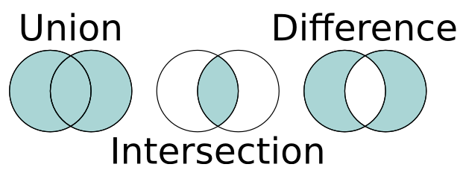
Redis Data Type - Set
Sets are unordered collections of strings
It's also possible to do a number of other operations against sets like testing if a given element already exists, performing the intersection, union or difference between multiple sets
https://redis.io/commands#set

Slide 35
Redis Data Type - Set
The SADD command adds new elements to a set
The SMEBERS get all the tags for a given object is trivial
The SISMEBER checking if an element exists in the set
> sadd myset 1 2 3
(integer) 3
> smembers myset
1. 3
2. 1
3. 2
> sismember myset 3
(integer) 1
> sismember myset 30
(integer) 0

Slide 36
Redis Data Type - Set
Returns the members of the set resulting from the intersection of all the given sets
key1 = {a,b,c,d}
key2 = {c}
key3 = {a,c,e}
SINTER key1 key2 key3 = {c}
> SADD key1 "a"
(integer) 1
> SADD key1 "b"
(integer) 1
> SADD key1 "c"
(integer) 1
> SADD key2 "c"
(integer) 1
> SADD key2 "d"
(integer) 1
> SADD key2 "e"
(integer) 1
> SINTER key1 key2
1) "c"

Slide 38
What is Kafka?
A streaming platform has three key capabilities:
Publish and subscribe to streams of records, similar to a message queue or enterprise messaging system (Wistron EAI)
Store streams of records in a fault-tolerant durable way
Process streams of records as they occur
Kafka is generally used for two broad classes of applications:
Building real-time streaming data pipelines that reliably get data between systems or applications
Building real-time streaming applications that transform or react to the streams of data
Notes:
Enterprise Application Integration，EAI

Slide 39

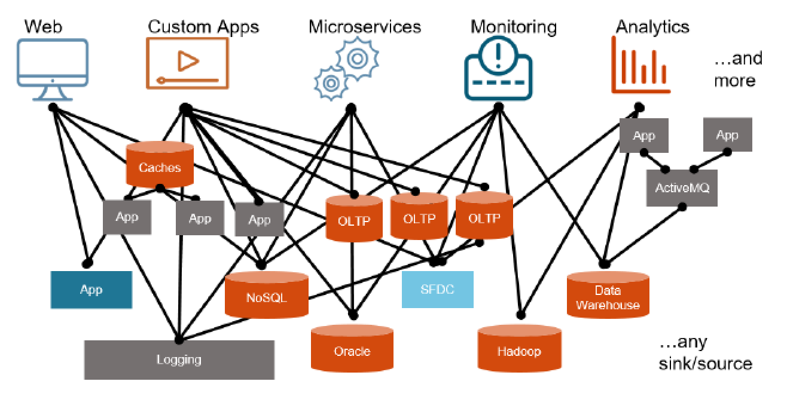
Why We need Kafka?

Slide 40
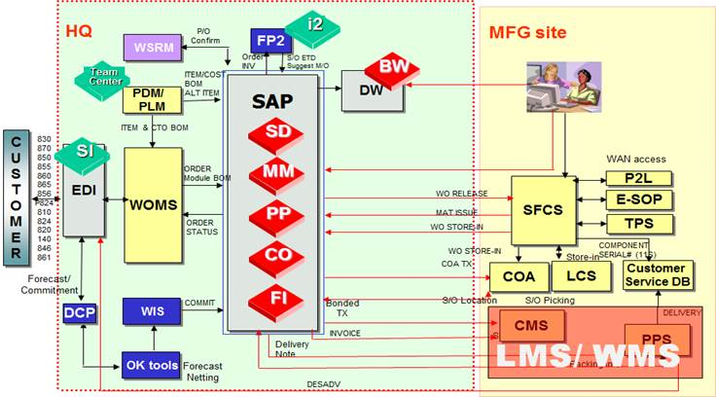
Why We need Kafka?
Notes:
BW: Business Warehouse
PLM: Product Lifecycle Management
SFCS: Shop Floor Control System 現場資訊監控系統
WSRM: Wistron Supplier Relationship Management
LMS: Logistics Management System
SD: Sales and Distribution
MM: Materials Management
PP: Production Plan and Control
FICO: Financial Accounting & Controlling

Slide 41

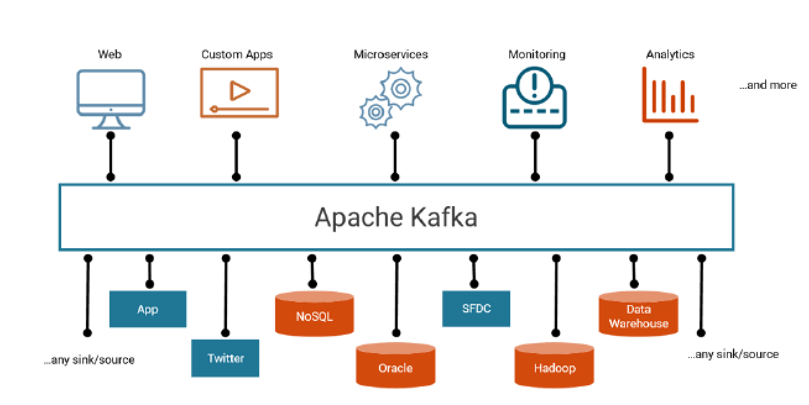
Why We need Kafka?
Message/Data Bus (Data as a Service)

Slide 42
Why We need Kafka?
Distributed, resilient architecture, fault tolerant
Horizontal scalability
High performance (latency of less than 10 ms ) – real time
Used by the 2000+ firms
LinkedIn
Netflix
AirBnb
FaceBook…

Slide 43
Basic Concepts for Kafka
Kafka is run as a cluster on one or more servers (broker) that can span multiple datacenters
Every message publish to Kafka called "Record“
Each record consists of a key, a value, and a timestamp
Kafka cluster stores streams of records in categories called topics

Slide 44
Basic Concepts for Kafka
Producer
Allows an application to publish a stream of records to one topics
Consumer
Allows an application to subscribe topics and process records
Streams
Allows an application to act as a stream processor, consuming an input stream from one or more topics and producing an output stream to one or more output topics
Connector

Slide 45
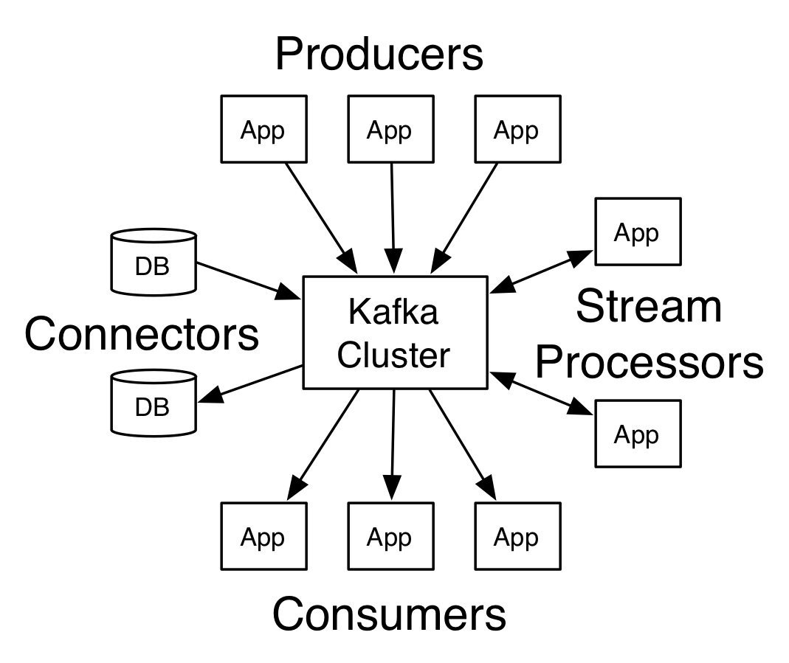
Basic Concepts for Kafka

Slide 46
Basic Concepts for Kafka - Abstraction
Record
Every message published to Kafka called "Record"
Record contains two parts
Key: Used by compaction or for message grouping
Value: The content of data goes

Slide 47
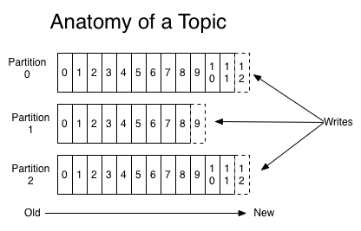
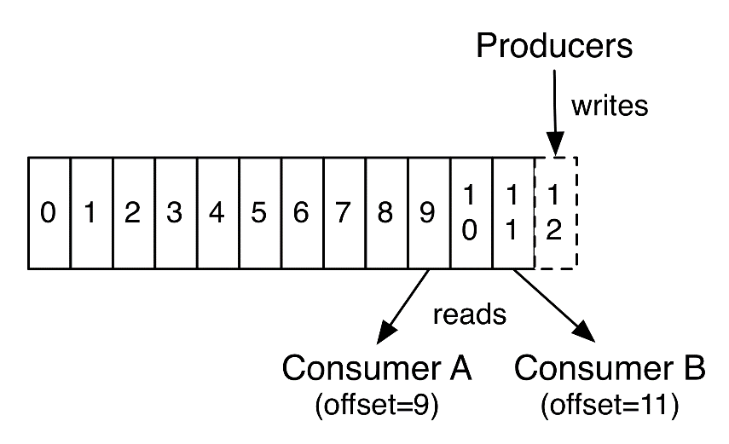
Basic Concepts for Kafka - Abstraction
Topics and Partitions
A topic is a category to which records are published
A topic can have 0, 1, or many consumers that subscribe to the data
For each topic, the Kafka cluster maintains a partitioned log

Slide 48
Basic Concepts for Kafka - Abstraction
Partitions and Offsets
Each partition is an ordered sequence of records that is continually appended
The records in the partitions are each assigned a sequential id number called the offset that uniquely identifies each record within the partition.

Slide 49
Basic Concepts for Kafka - Physical
Kafka Cluster
Consumer Group A
Consumer 1
Producer
Broker 1
Consumer 2
Consumer 3
Producer
Broker 2
Consumer Group B
…
Consumer 1
Zookeeper
Stores Information about cluster status and consumer offsets
Broker N
Consumer 2

Slide 50
Basic Concepts for Kafka
Broker. A Kafka cluster is composed of multiple brokers (servers)
Each is identified with its ID (integer)
Each broker contains certain topic partitions
After connecting to any broker (called a bootstrap broker), you will be connected to the entire cluster
A good number of cluster to get started is 3 brokers, but some clusters have over 100 brokers

Slide 51
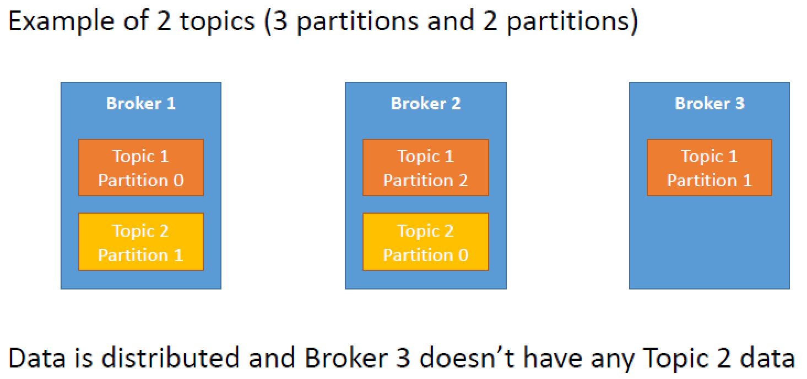
Basic Concepts for Kafka
Brokers and Topics

Slide 52
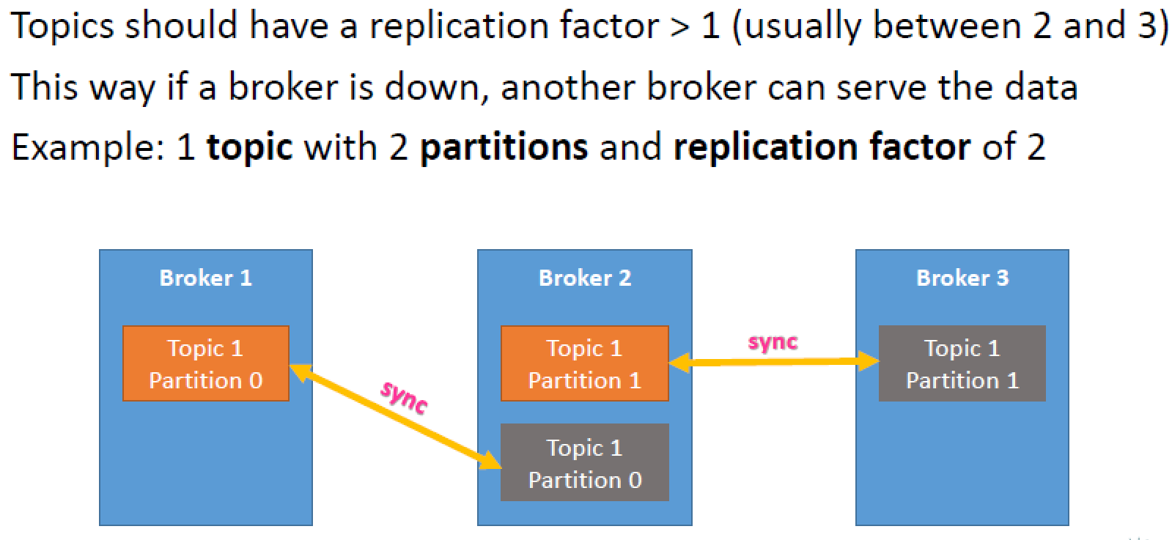
Basic Concepts for Kafka
Brokers and Topics

Slide 53
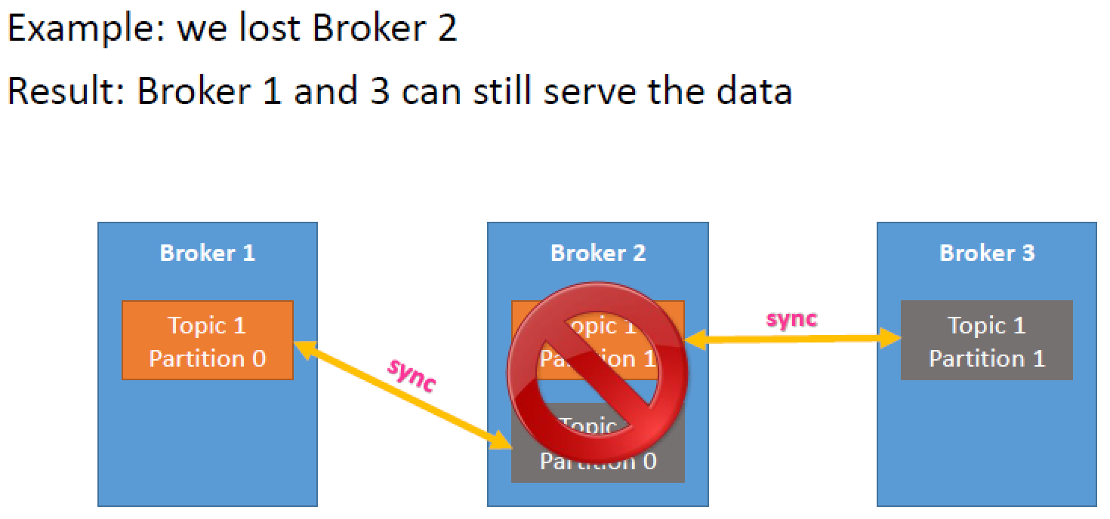
Basic Concepts for Kafka
Brokers and Topics

Slide 54
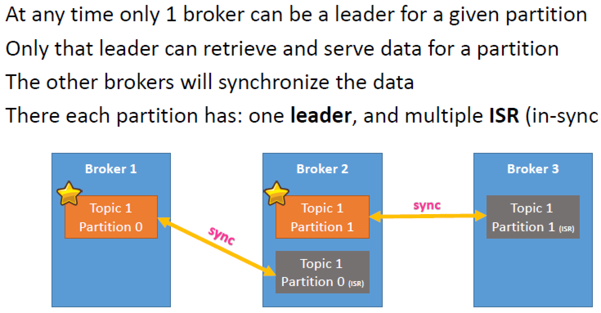
Basic Concepts for Kafka
Brokers and Topics

Slide 55
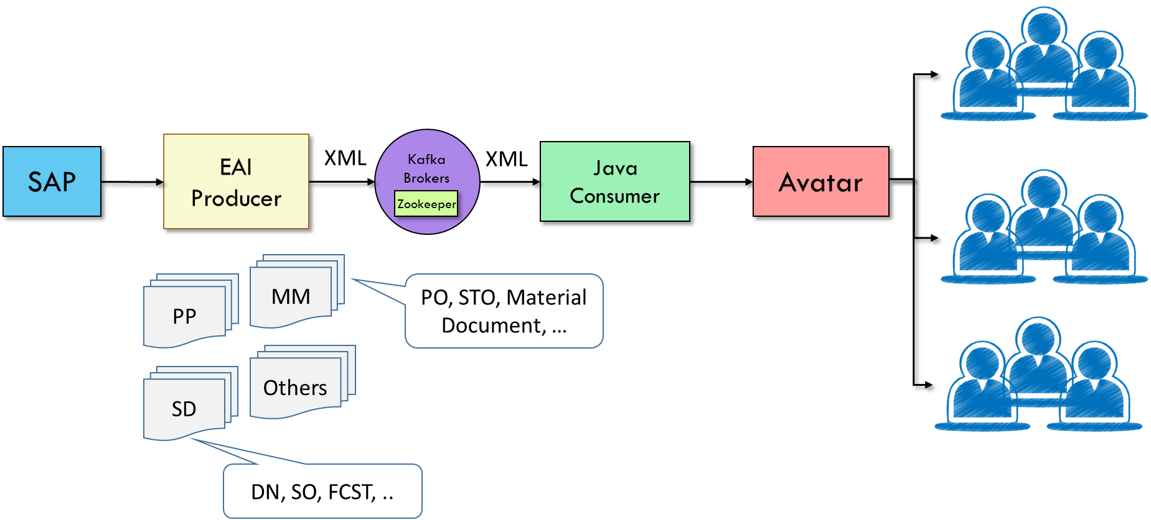
SAP & Avatar – AS-IS

Slide 56
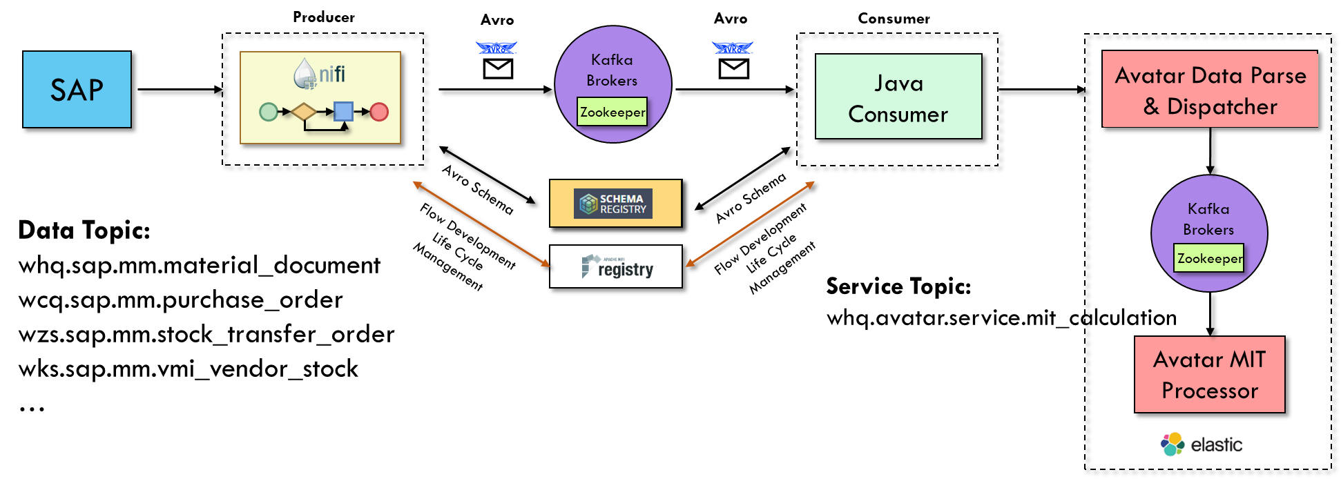
SAP & Avatar - Coming..

Slide 57


Slide 58

About IOT
IOT (Internet of Things)
Enables devices to collect and exchange data through Internet -- machine-to-machine (M2M)
Based on hardware (sensors & devices), software, and network connectivity
IOT architecture:
Sensor Layer, Network Layer and Application Layer
Notes:
1. 感知層(Sensor Layer)－由各種RFID標籤、有線及無線感測器(Wired & Wireless Sensor)所組成，負責傳遞感測資料，這部分是發展感測元件廠商可布局之處。
2. 網路層(Network Layer)－由各種極低功耗的有線／無線網路規範，如802.15.4、6LoWPAN、ANT、WirelessHART、ZigBee、MiWi、WIA-PA、ISA100等協定，以及802.11 Wi-Fi、甚至2G GSM/2.75G GPRS/3G CDMA/3.5G WCDMA/4G LTE等行動通訊協定，將各種感測器的資料上傳到雲端伺服器，這部分將是提供各種無線網路協定的軟／硬體元件廠商，網通設備供應商、電信營運服務商，以及網際網路服務商(ISP)、雲端服務供應商的市場。
3. 應用層(Application Layer)－它涵蓋到應用領域相當廣泛，從環境監測、無線感測網路(Wireless Sensor Network；WSN)、智慧電網(Smart Grid)與能源管理、醫療照護(Health Care)、食品管制系統、產品供應鏈，以及從智慧家庭(Smart Home)、智慧建築(Building Management)、智慧工廠(Smart Factory)，以至於延伸到智慧交通運輸／物流、甚至智慧都市的大範圍的應用，可說是山也能IoT，海也能IoT。

Slide 59
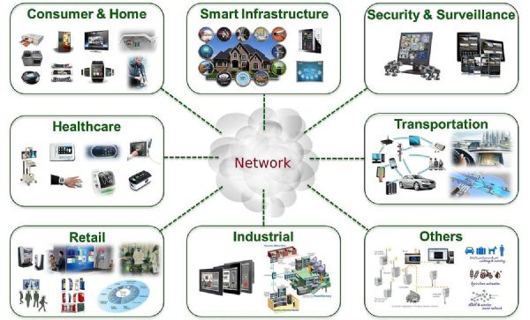
IOT Case Studies

Slide 60

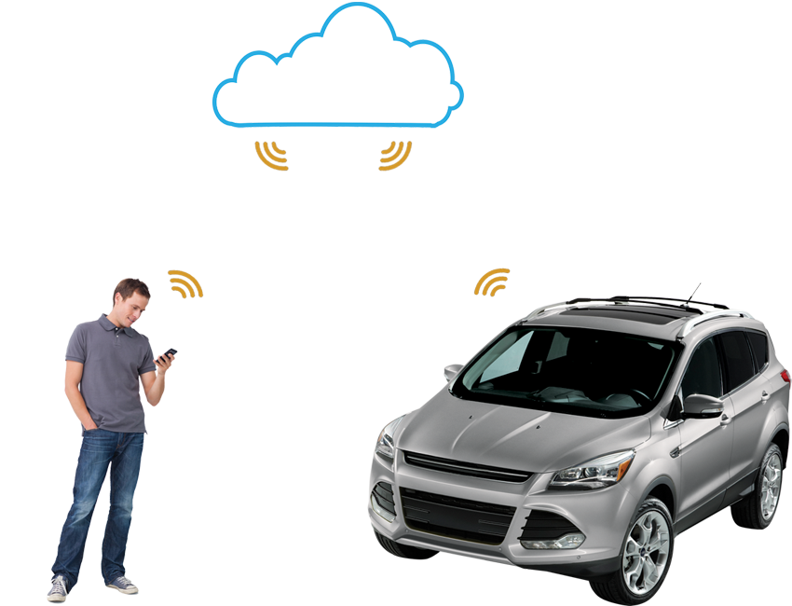
IOT Case Studies - Security
Notes:
家中一感測到有物體移動, 或是車輛被強力震動, 便發出警告通知主人
用data push的概念說, 多數時間建築是安全的, 總不會像便利商店一樣小偷一直進進出出, 所以server用data pull的概念不實際

Slide 61
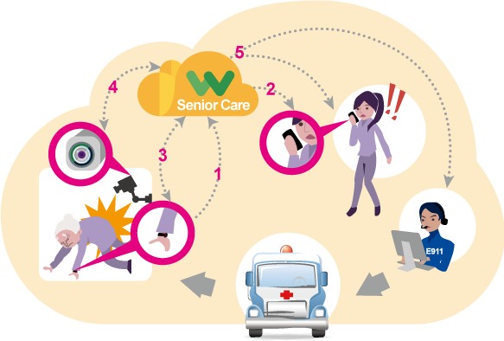
IOT Case Studies - Healthcare
Notes:
穿戴裝置一感測到老人或幼兒脈搏不正常升高或降低, 便發出警告通知主人
用data push的概念說, 多數時間人是健康的, 如果心跳沒事有問題醫院應該不會讓你回家, 所以server用data pull的概念不實際

Slide 62
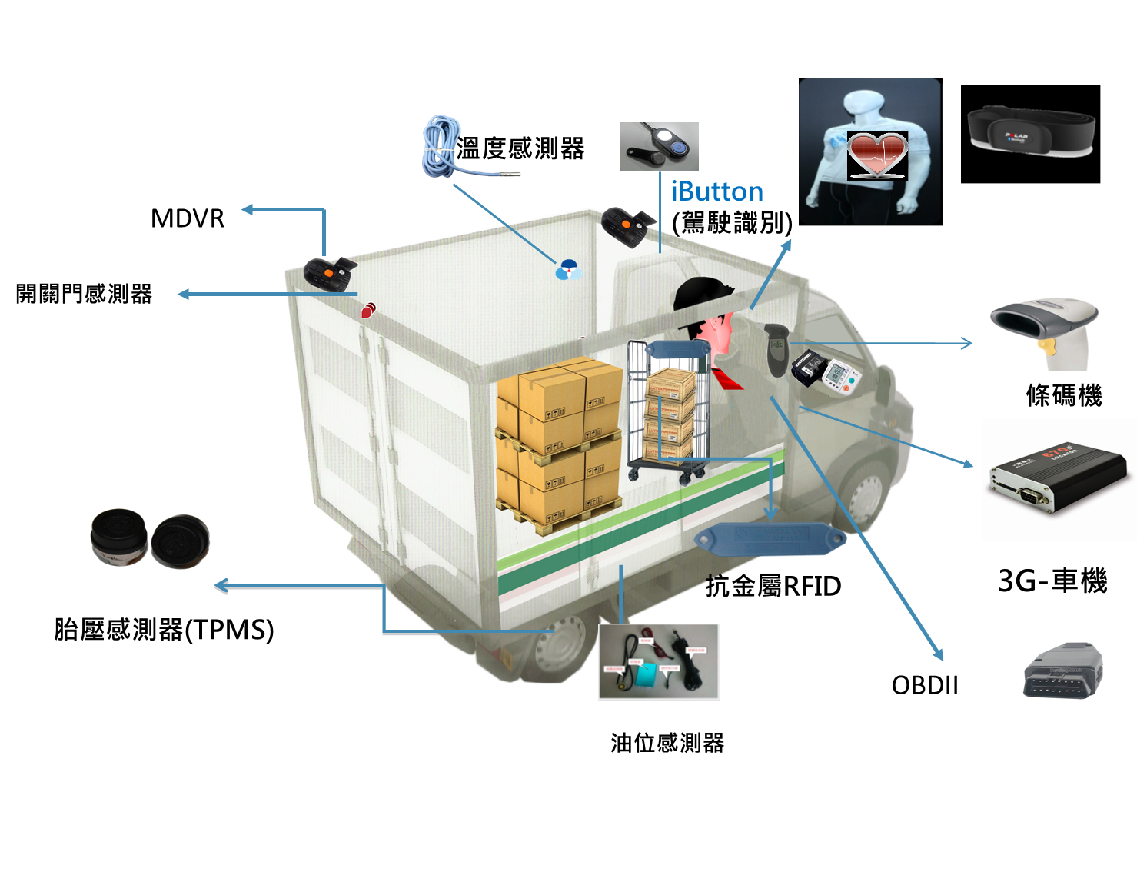
IOT Case Studies - Transport
Notes:
這邊特別的是無線環境, 需確保資料送達server,
此系統用於確保運輸人員健康狀態, 行車安全, 貨物運輸狀態

Slide 63
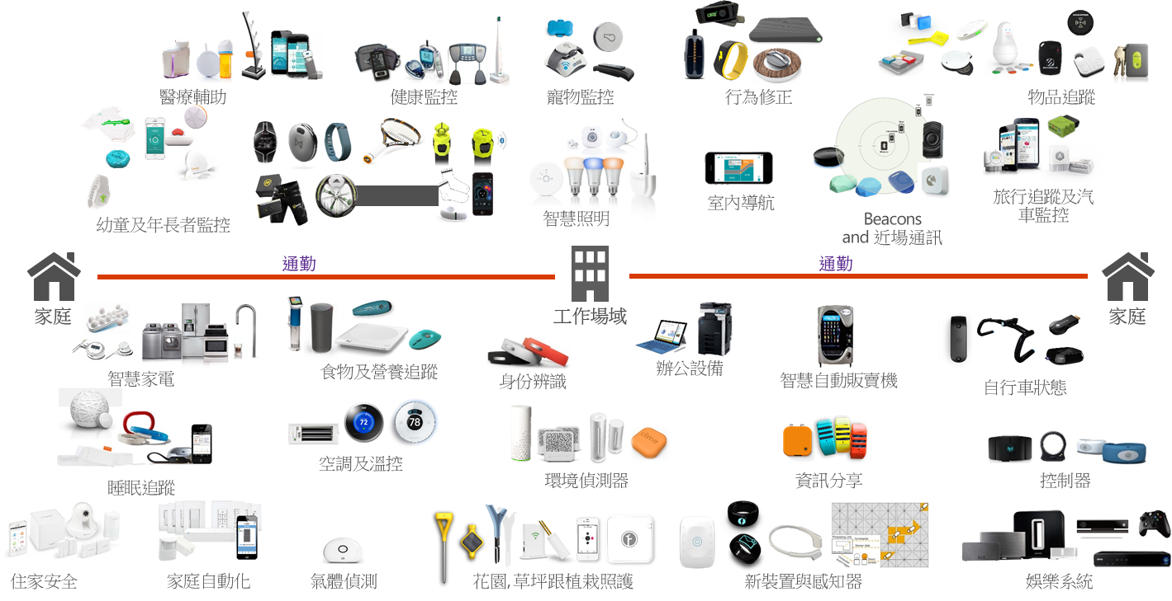
IOT Case Studies - Others

Slide 64







Push vs Pull Message
Deliver information in real time
Without unnecessary request/response
Pull Model
Request/Response
Data producer
Data consumer
Push Model
Server push / Messaging
Notes:
在前些年的企業應用系統, 多以pull為概念
但上述case, 皆是以push為概念, 因為pull並不適用, 耗費頻寬, 不必要資料request, device的電力消耗
在以手機上的通訊軟體為例, 應該是要低傳輸量, 讓電子消耗及網路頻寬使用降到最低 (省錢)

Slide 65
MQTT Introduction
Why we need MQTT in IOT?
Ensure reliability of messaging delivery
Minimizes network bandwidth requirements
Run on an embedded device with limited processor or memory resources

Slide 66


MQTT Introduction
Notes:
北半球的主要洋流(墨西哥灣流等)受到北極海融冰產生的冷水團阻擋而流不動了
這邊的sensor, 是無線且無電力支援,
如遇戰爭更是如此

Slide 67
MQTT Introduction
MQTT (Message Queue Telemetry Transport)
A Client/Server publish/subscribe messaging transport protocol (i.e. push model)
It is light weight, open, simple, and designed so as to be easy to implement
It is suitable for IOT (M2M)
M2M (machine-to-machine), IOT (internet of things)

Slide 68
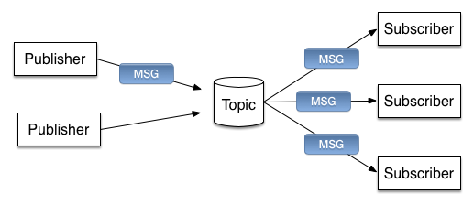
MQTT Introduction
MQTT Components
Publisher, Subscriber and Topic
MQTT
Broker
Server

Slide 69
MQTT Features
Provides one-to-many message distribution and decoupling of applications
A messaging transport that is agnostic (不可知) to the content of the payload
Last will and testament (遺囑)
A small transport overhead and exchanges minimized to reduce network traffic
The fixed-length header is just 2 bytes
Notes:
它是發佈/訂閱通訊協定。
除提供一對多訊息配送之外，發佈/訂閱還會取消連結應用程式。在具有許多用戶端的應用程式中，這兩種特性都很有用。
無論如何它不依賴於訊息內容。
它透過 TCP/IP 執行，TCP/IP 提供基本網路連線功能。
它具有三種用於訊息遞送的服務品質：至多一次根據基礎「網際網路通訊協定」網路的最佳效能遞送訊息。訊息可能會遺失。例如，將此服務品質與通訊的環境感應器資料搭配使用。如果不久後會發佈下一個閱讀，則個別閱讀是否遺失並不重要。至少一次保證訊息會送達，但可能會重複。只一次保證訊息只送達一次。例如，將此服務品質與帳單系統搭配使用。訊息重複或遺失可能會導致不方便或徵收不正確的費用。
在網路上管理訊息流程的方式非常經濟。例如，固定長度標頭的長度僅 2 個位元組，且會最大限度地減少通訊協定交換以減少網路資料流量。
它具有「最後留言」特性，可通知訂閱者用戶端與 MQTT 伺服器的連線異常中斷。請參閱最後留言發佈。

Slide 70
MQTT Features
QoS (Quality of Service) level in MQTT
0: at most once
The message is delivered at most once
1: at least once
The message might be delivered multiple times until an acknowledgment is received by the sender
2: exactly once
The message must be stored locally at the sender
Until the sender receives confirmation that the message has been received by the receiver
QoS 2 must ensure no duplication of messages occurs at the receiver
Notes:
它是發佈/訂閱通訊協定。
除提供一對多訊息配送之外，發佈/訂閱還會取消連結應用程式。在具有許多用戶端的應用程式中，這兩種特性都很有用。
無論如何它不依賴於訊息內容。
它透過 TCP/IP 執行，TCP/IP 提供基本網路連線功能。
它具有三種用於訊息遞送的服務品質：至多一次根據基礎「網際網路通訊協定」網路的最佳效能遞送訊息。訊息可能會遺失。例如，將此服務品質與通訊的環境感應器資料搭配使用。如果不久後會發佈下一個閱讀，則個別閱讀是否遺失並不重要。至少一次保證訊息會送達，但可能會重複。只一次保證訊息只送達一次。例如，將此服務品質與帳單系統搭配使用。訊息重複或遺失可能會導致不方便或徵收不正確的費用。
在網路上管理訊息流程的方式非常經濟。例如，固定長度標頭的長度僅 2 個位元組，且會最大限度地減少通訊協定交換以減少網路資料流量。
它具有「最後留言」特性，可通知訂閱者用戶端與 MQTT 伺服器的連線異常中斷。請參閱最後留言發佈。

Slide 71
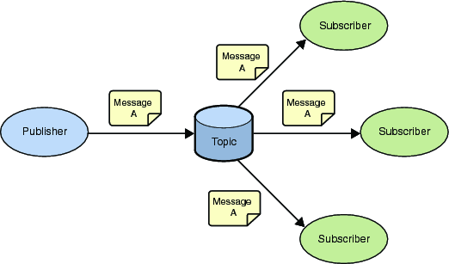
MQTT Publish/Subscribe

Slide 72
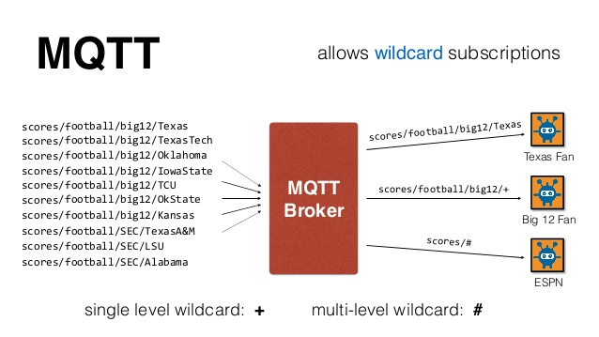
MQTT Features
Notes:
收聽足球聯盟戰積
B12大聯盟
SEC聯盟

Slide 73
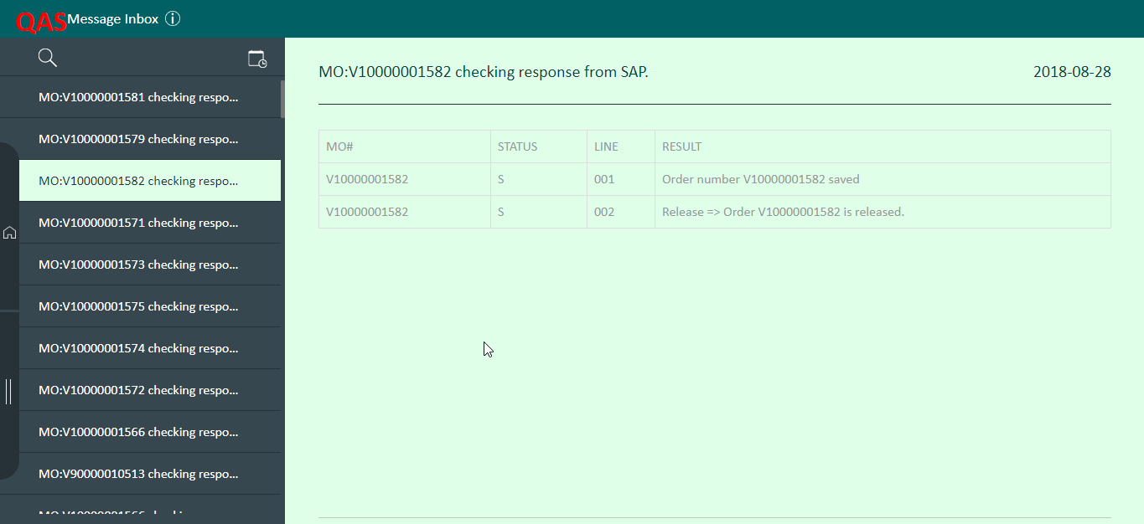
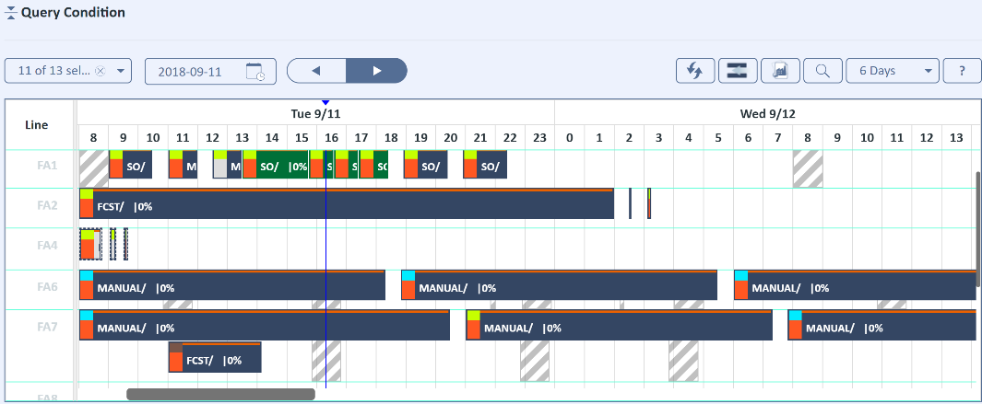
MQTT in Avatar
Inbox on UI
Event trigger for application
Collaborative Scheduling

Slide 74
About Open Source…
世上沒有萬靈丹….
知其然, 知其所以然

Slide 75
My first API

Slide 76
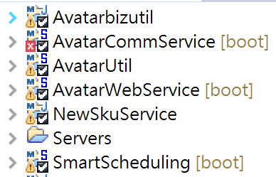
Avatar Projects
AvatarUtils: Common functions
Avatarbizutils: Common functions related business logic
AvatarCommonService: APIs for common UI functions (Login.. Weather.. )
AvatarWebService: Kafka consumers and APIs for business functions (FCST.. Supply..)
SmartScheduling: Smart Scheduling APIs and Jobs
MPSP: MPSP APIs and Jobs
….

Slide 77
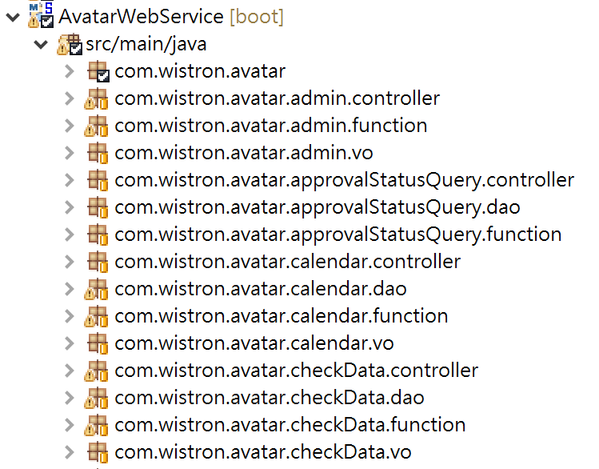
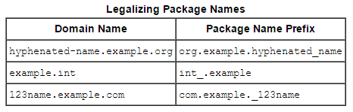
Avatar Packages
com.wistron.avatar.{ServiceName}.controller
com.wistron.avatar.{ServiceName}.function
com.wistron.avatar.{ServiceName}.dao
com.wistron.avatar.{ServiceName}.vo

Slide 78
com.wistron.avatar.{ServiceName}.controller
package com.wistron.avatar.newcomertraining.controller;
import org.springframework.web.bind.annotation.*;
import org.springframework.web.context.request.*;
/**
* Controller for Demo
*/
@RestController
@RequestMapping(path = "/Demo")
public class DemoController {
/**
* Process
* @param Object param
* @return AvatarResponse
*/
@RequestMapping(path = "/process", method = RequestMethod.POST)
public AvatarResponse process(@RequestBody Object param) throws Exception {
//...
}

Slide 79
com.wistron.avatar.{ServiceName}.function
package com.wistron.avatar.newcomertraining.function;
/**
* Functions for Demo
*/
public class DemoFunction {
/**
* Start to process
*
* @param String plant
* @return DemoVO
* @throws Exception
*/
public DemoVO process(String plant) throws Exception {
//...
}

Slide 80
com.wistron.avatar.{ServiceName}.dao
package com.wistron.avatar.newcomertraining.dao;
/**
* DAOs for Demo
*/
public class DemoDAO {
/**
* Start to process
*
* @param String plant
* @return DemoVO
* @throws Exception
*/
public DemoVO process(String plant) throws Exception {
//...
}

Slide 81
com.wistron.avatar.{ServiceName}.vo
package com.wistron.avatar.newcomertraining.vo;
/**
* Value Object for Demo
*/
public class DemoVO {
private String plant;
//…
public String getPlant() {
return plant;
}
public void setPlant(String plant) {
this.plant = plant;
}
//…
}

Slide 82
Java Naming Rule
Packages → Lowercase
package org.company.application.service.category
Classes → Upper Camel Case (initial uppercase letter). The Names should be nouns
class MMConsumer
Interfaces → Upper Camel Case. The beginning letter with an "I"
interface IComparable

Slide 83
Java Naming Rule
Methods → Lower Camel Case (initial lowercase letter). The first letter should be verbs
public string getName() {
Variables → Lower Camel Case. The Names should be nouns
List<String> plantList = null;

Slide 84
Dev. Tools
ES Head (ES CRUD): http://10.37.36.2:9200/_plugin/head/
ES KOPF (ES Monitor): http://10.37.36.2:9200/_plugin/kopf/
Redis Destop Manager: \\10.38.36.36\lync_recording_server\ML2\ML2700\02_Public\New_comer_Training\Back_end\redis-desktop-manager.zip
PL/SQL, SQL Developer
PostMan (API development environment): Chrome App installer

Slide 85
Dev. Tools
NotePad++: https://notepad-plus-plus.org/zh/
Json Formatter: https://jsonformatter.curiousconcept.com/
XML Formatter: http://www.webtoolkitonline.com/xml-formatter.html
Wistron ITSM: http://10.37.34.27:8080/ITSM
Wistron ITKM: http://itkm.wistron.com

Slide 86
References..
https://www.elastic.co/guide/index.html
https://redis.io/documentation
https://kafka.apache.org/intro
http://docs.oasis-open.org/mqtt/mqtt/v3.1.1/os/mqtt-v3.1.1-os.pdf

Slide 87
References..
http://spring.io/projects/spring-boot
https://openhome.cc/Gossip/SpringGossip/
https://www.thoughtco.com/using-java-naming-conventions-2034199

